Slide 1
Multi-Cell RTT + AoA Positioning Demo
06/24/2021
Location
@qualcomm

Slide 2
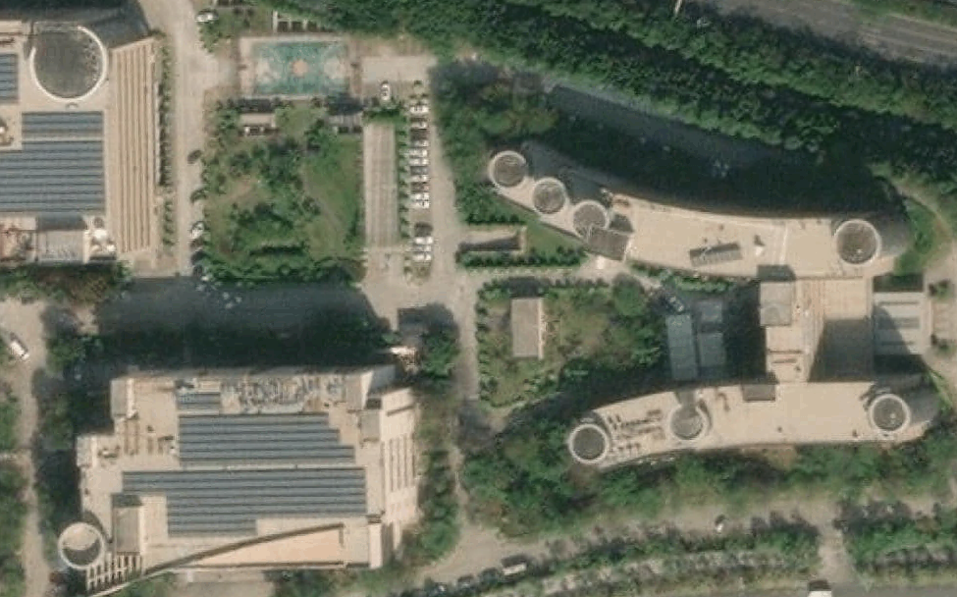
Field Test Network Setup
ISD
gNBs
  ZTE 64 TxRUs with positioning capability
  30~40 meters above ground
  Tx Power: ???
  Down tilt:
    gNB 1(PCI 1), 10.3
    gNB 2(PCI 2), 7.9
    gNB3 (PCI 993), 18
    gNB4 (PCI 996), 21.5
    gNB5 (PCI 90),20.5
UE:
  SDX60 supporting up to 16 cells simultaneously for positioning
Location server:
  Designed and operated by QC
SA mode with 100 MHz @n41
gNB1
50m
160m
127m
gNB5
135m
gNB4
50m
90m
65m
gNB2
gNB3

Slide 3
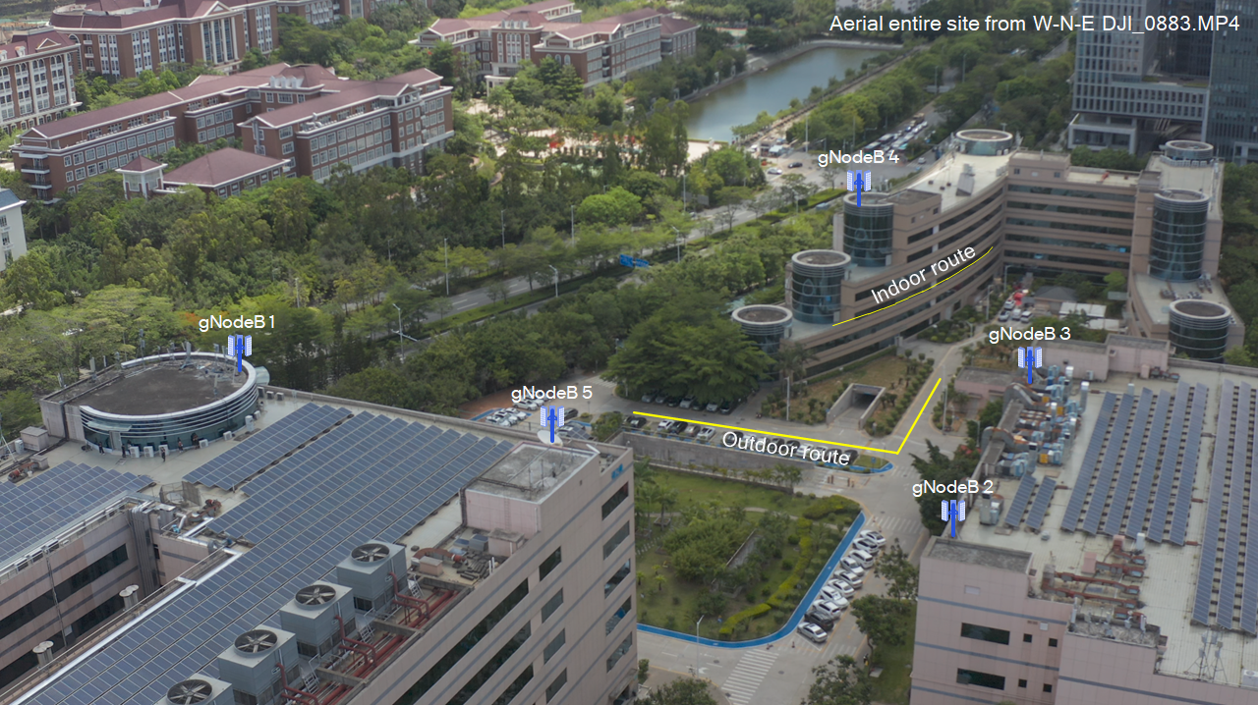
Overview of Test Routes

Slide 4
Outdoor Test Route
100m
170m
45m
115m
110m
35m
90m
30m
60m

Slide 5
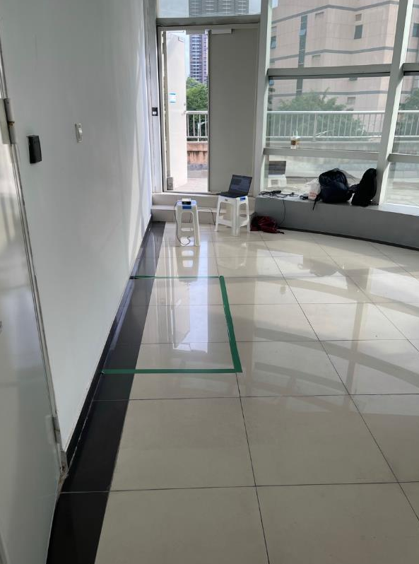
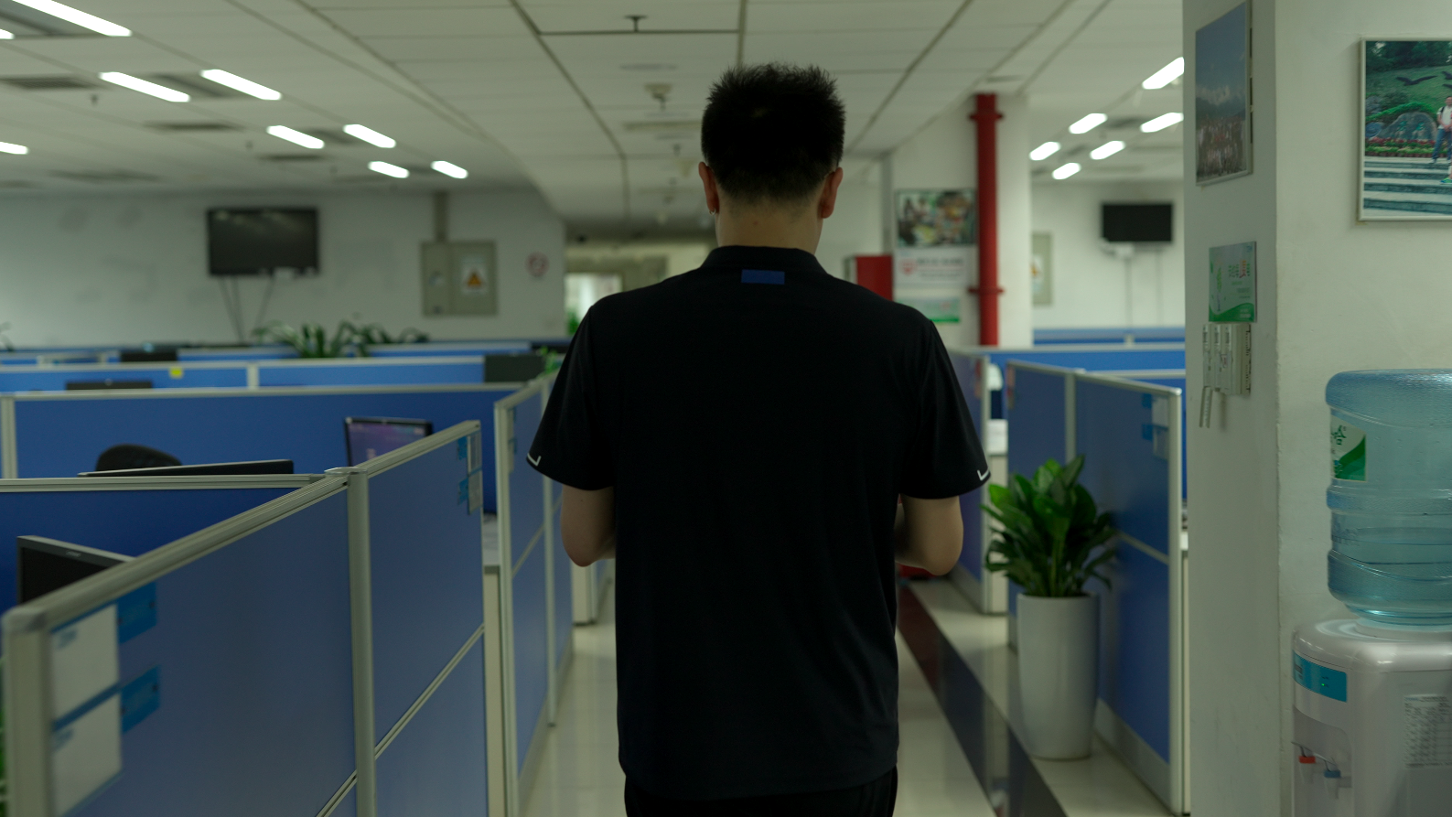
Indoor Test Route
150m
140m
130m
100m

Slide 6
Reference Signal Configuration
PRS
  Periodicity： 160ms
  # of Slots： 1 slot
  # of symbols per slot： 2 symbol
  Comb： comb2
SRS for positioning
  Periodicity： 160ms
  Slots： 1 slot
  # of symbols per slot： 2 symbol
  Comb： comb4

Slide 7
Network Architecture

Slide 8
Call Flow
Proprietary messages

Slide 9
MC-RTT Demo Video

Slide 10



/ /
5G NR positioning joint field trial results
Based on round trip time (RTT) and angle of arrival (AoA)
Raw* positioning accuracy
Line-of-sight (LOS) condition trial route:
 | Horizontal Accuracy |  | Vertical Accuracy
 | 50th-percentile | 80th-percentile | 50th-percentile | 80th-percentile
Single-cell Positioning | 1.6 m | 2.1 m | 0.8 m | 1.2 m
Multi-cell Positioning | 0.6 m | 1.0 m | 0.5 m | 1.0 m
*Instantaneous location estimates with no temporal processing, no GNSS or other sensor data assistance
Multi-cell RTT and AoA based implementation improves accuracy

Slide 11
/ /
5G NR positioning joint field trial results
Based on round trip time (RTT) and angle of arrival (AoA)
Raw* positioning accuracy
Indoor trial route with outdoor network:
 | Horizontal Accuracy |  | Vertical Accuracy
 | 50th-percentile | 80th-percentile | 50th-percentile | 80th-percentile
Good coverage | 1.5 m | 2.3 m | 0.6 m | 1.2 m
Edge coverage | 5.0 m | 7.0 m | 1.1 m | 2.2 m
*Instantaneous location estimates with no temporal processing, no GNSS or other sensor data assistance
Wide-area outdoor 5G multi-cell positioning provides high accuracy even in challenging deep indoor conditions

Slide 12
/ /
5G NR positioning joint field trial results
Based on round trip time (RTT) and angle of arrival (AoA)
Raw* positioning accuracy
Indoor trial route with outdoor network :
 | Horizontal Accuracy |  | Vertical Accuracy |  | 50th-percentile RSRP (dbm) | Number of Test Points
 | 50th-percentile | 80th-percentile | 50th-percentile | 80th-percentile
Test Route1 | 1 | 1.7 | 0.75 | 1.23 | -63 | 15
Test Route2 | 1.59 | 2.58 | 0.48 | 1.13 | -84 | 46
Test Route3 | 6.02 | 7.63 | 0.87 | 2.1 | -95 | 51
Test Route4 | 4.31 | 5.23 | 1.54 | 2.07 | -92 | 33
*Instantaneous location estimates with no temporal processing, no GNSS or other sensor data assistance
Wide-area outdoor 5G multi-cell positioning provides high accuracy even in challenging deep indoor conditions

Slide 13
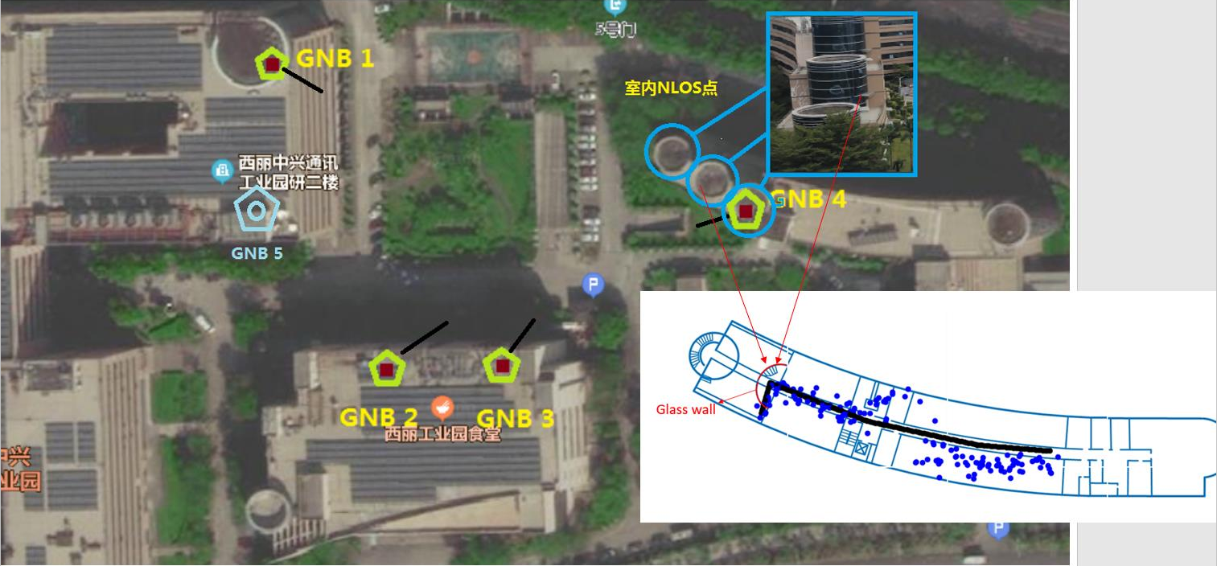

Slide 14
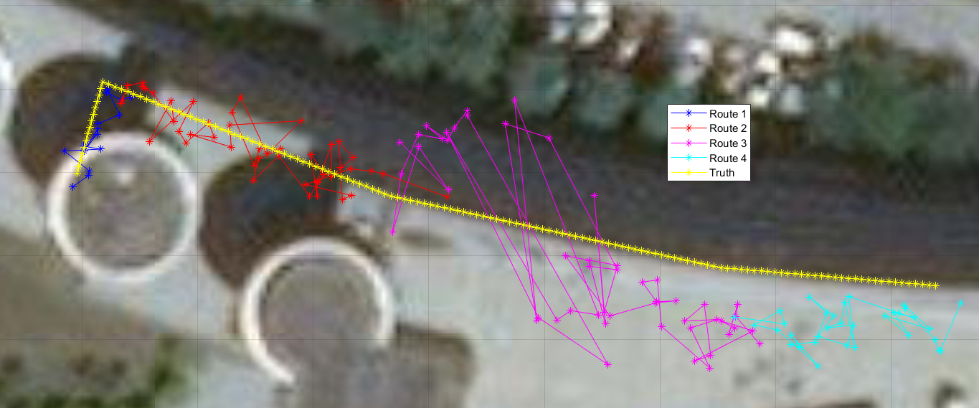
/ /
5G NR positioning joint field trial results
Based on round trip time (RTT) and angle of arrival (AoA)

